Slide 1
10 June 2020
1

Slide 2

APPLIED CRYPTOGRAPHY
Lecture 38
2

Slide 3
KDC working example
Authentication protocol that works based on tickets
3

Slide 4
Data
How Data Is Protected depends on
Access to data:
Availability of data
Performance
Liability of data

Slide 5
Basic rules used to enable security:
Ensure that security does not impede performance or availability
Pick the right encryption scheme
Ensure that the security solution can evolve with your changing requirement

Slide 6
Points of Vulnerability

Slide 7
Confidentiality using Symmetric Encryption
Link Encryption
End-to-End Encryption
S
D

Slide 8
Required Key Protection

Slide 9
Key Storage
In Files
Using access control of operating system
In Crypto Tokens
Smart card, USB crypto token
Supports complete key life-cycle on token
Generation – storage – use – destruction
provide means to ensure that there is no way to get a key out
Key Backup (also known as key escrow)

Slide 10
Key Renewal
Keys should be renewed
More available cipher texts may facilitate certain attacks
How often depends on the crypto algorithm
Can depend on the amount of encrypted data
May depend on time (exhaustive key search requires time)
Regular key renewal can reduce damage in case of (unnoticed) key compromise
Protocols like SSL/TLS include features for (secret) key renewal

Slide 11
Key Life-Cycle

Slide 12
Key Distribution
Means of Exchanging Keys between two parties
Keys are used for conventional encryption
Frequent key exchanges are desirable
Limiting the amount of data compromised
Strength of cryptographic system rests with Key Distribution Mechanism
Symmetric schemes require both parties to share a common secret key
Issue is how to securely distribute this key
Often a secure system failure due to a break in the key distribution scheme

Slide 13
KDC

Slide 14
Session Key Lifetimes
Session key lifetimes should be limited for greater security
More frequently the session keys are exchanged, more secure they become
For connection oriented protocols, it should be valid for the duration of connection
For connectionless protocols key should be valid for a certain duration

Slide 15
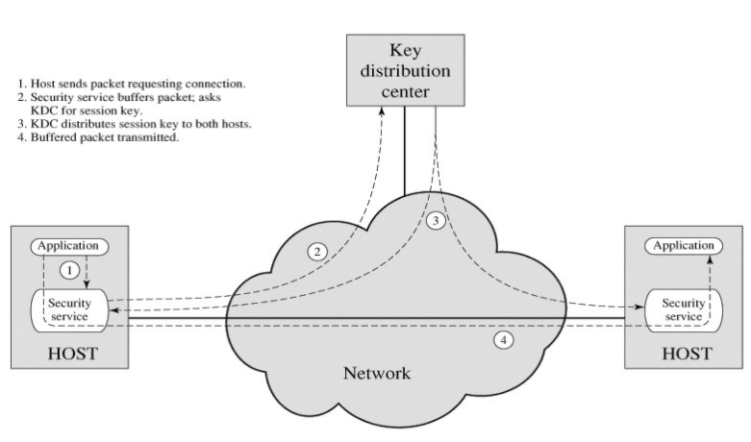
Transparent Key Control

Slide 16
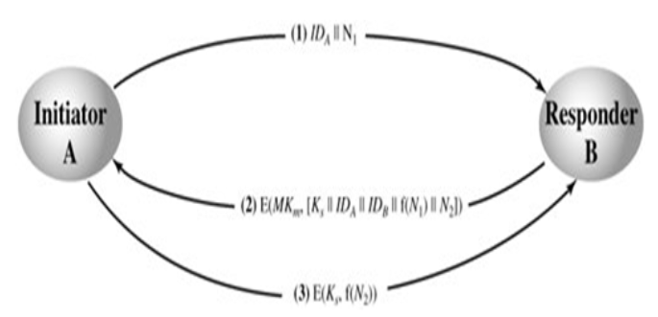
Decentralized Key Control

Slide 17
Different types of session keys e.g.
Data encrypting key: for general communication across network
PIN-encrypting key: for PIN used in electronic funds
File encrypting key: for encrypting files stored on a publicly accessible location

Slide 18
Key Distribution
Session key
Data encrypted with a one-time session key. At the conclusion of the session the key is destroyed
Permanent key
Used between entities for the purpose of distributing session keys

Slide 19
Kerberos KDC authentication
Kerberos is a network authentication protocol. It is designed to provide strong authentication for client/server applications by using secret-key cryptography. The Kerberos architecture is designed around messages exchange between three kinds of entities:
The clients that use kerberos services.
The servers that provide services (The clients and servers are collectively referred to as principals).
The servers that manage the Kerberos protocol itself. These servers are often called KDCs (Key Distribution Centers), and comprise of several modular services.

Slide 20
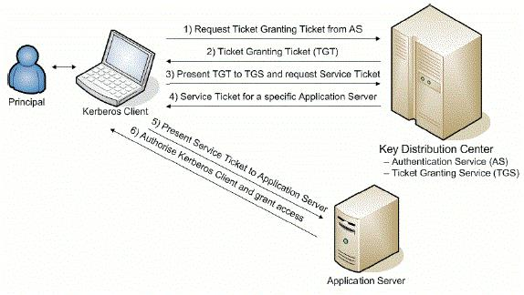
Example: list directory from HDFS on Kerberos enabled Hadoop cluster

Slide 21
Thank You!
Next Class
Mandatory reading for the next class
https://www.hjp.at/doc/rfc/rfc5021.html
10 June 2020
21

Slide 22


Rajashree S
Computer Science and Engineering
PES University, Bengaluru
10 June 2020
22

